Slide 1
Guidance – delete after reading
The purpose of these slides is to provide additional supportive communication material for our LPS collaborators to introduce their study participants to the concept of UK LLC opening up for research beyond COVID-19.
The slides cover: who UK LLC are, our LPS collaborators, what UK LLC does and how, what is changing (opening up for research beyond COVID-19) and how this is in the public good.
These slides are intentionally information-heavy to allow each LPS to best edit for their own purpose.
Please refer to the UK LLC Fair Processing library of materials for further information, or contact the team directly.
Don’t forget to delete this slide before saving your presentation.
This material and content has been co-produced by the UK LLC team with its partners. Copying and Licence information (CC-BY-SA). The material on this site is copyright (c) 2020-2024 of the University of Bristol. It is open and licensed under the Creative Commons Attribution ShareAlike License (CC-BY-SA) v4.0. CC BY-SA includes the following elements: BY – Credit must be given to the creator; SA – Adaptations must be shared under the same terms. The full CC-BY-SA text may be found at: https://creativecommons.org/licenses/by-sa/4.0/

Slide 2

UK LLC: Research beyond COVID-19
June 2024
Notes:
This material and content has been co-produced by the UK LLC team with its partners. Copying and Licence information (CC-BY-SA). The material on this site is copyright (c) 2020-2024 of the University of Bristol. It is open and licensed under the Creative Commons Attribution ShareAlike License (CC-BY-SA) v4.0. CC BY-SA includes the following elements: BY – Credit must be given to the creator; SA – Adaptations must be shared under the same terms. The full CC-BY-SA text may be found at: https://creativecommons.org/licenses/by-sa/4.0/

Slide 3











UK Longitudinal Linkage Collaboration (UK LLC) is a partnership of Universities and Longitudinal Population Studies funded by the UK Government’s Research Councils.
Who are UK LLC?
Led by:
In collaboration with:
Originated as part of the COVID-19
Longitudinal Health and Wellbeing National Core Study
Funded by:
Notes:
This material and content has been co-produced by the UK LLC team with its partners. Copying and Licence information (CC-BY-SA). The material on this site is copyright (c) 2020-2024 of the University of Bristol. It is open and licensed under the Creative Commons Attribution ShareAlike License (CC-BY-SA) v4.0. CC BY-SA includes the following elements: BY – Credit must be given to the creator; SA – Adaptations must be shared under the same terms. The full CC-BY-SA text may be found at: https://creativecommons.org/licenses/by-sa/4.0/

Slide 4





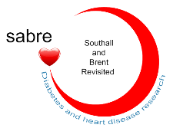














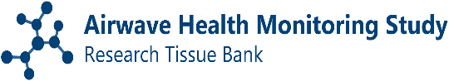
UK LLC provides the national Trusted Research Environment (TRE) for over 20 contributing Longitudinal Population Studies (LPS).
Contributing LPS
Notes:
This material and content has been co-produced by the UK LLC team with its partners. Copying and Licence information (CC-BY-SA). The material on this site is copyright (c) 2020-2024 of the University of Bristol. It is open and licensed under the Creative Commons Attribution ShareAlike License (CC-BY-SA) v4.0. CC BY-SA includes the following elements: BY – Credit must be given to the creator; SA – Adaptations must be shared under the same terms. The full CC-BY-SA text may be found at: https://creativecommons.org/licenses/by-sa/4.0/

Slide 5
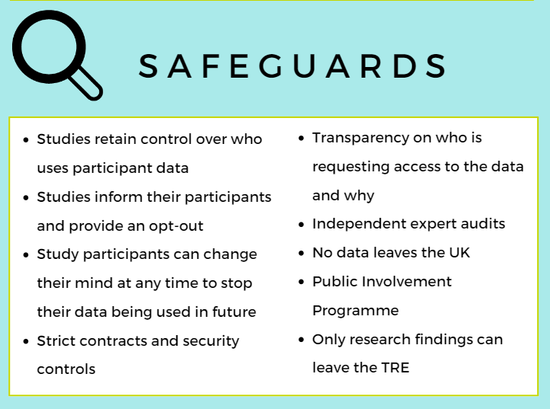
What does UK LLC do?
UK LLC is responsible for securely storing and accurately maintaining de-identified LPS datasets. Where consent has been given, these datasets are linked with de-identified, health, non-health and administrative data and made available for research in the public good.
UK LLC is the national Trusted Research Environment (TRE) for longitudinal research in the UK. A TRE is a secure computer system where researchers can access and study data. Data is available in the same way as a reading library - researchers can view the information but cannot take it out.
SeRP UK at Swansea University are the trusted third party that provides the TRE for UK LLC.
Access to confidential and sensitive data is legally protected. Data can only be viewed by UK based accredited researchers from recognised institutions who have been approved to handle it. This approval is provided through the Office for National Statistics and is regulated by the Digital Economy Act 2017.
Notes:
This material and content has been co-produced by the UK LLC team with its partners. Copying and Licence information (CC-BY-SA). The material on this site is copyright (c) 2020-2024 of the University of Bristol. It is open and licensed under the Creative Commons Attribution ShareAlike License (CC-BY-SA) v4.0. CC BY-SA includes the following elements: BY – Credit must be given to the creator; SA – Adaptations must be shared under the same terms. The full CC-BY-SA text may be found at: https://creativecommons.org/licenses/by-sa/4.0/

Slide 6
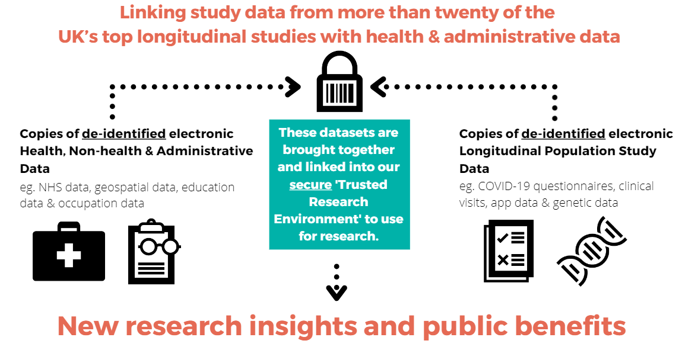
How does UK LLC work?
Through the Trusted Research Environment (TRE), UK LLC provides unique, interdisciplinary, four nations UK data linkage for longitudinal research that benefits the public.
De-identified data is data which has had personally identifiable information such as name, address and full date of birth removed or scrambled.
UK LLC are certified and audited for the most rigorous data security standards available in the UK. This includes ISO 27001 certification, UK Statistics Authority accreditation and NHS Digital Data Security approval.
UK LLC: Research beyond COVID-19
Notes:
This material and content has been co-produced by the UK LLC team with its partners. Copying and Licence information (CC-BY-SA). The material on this site is copyright (c) 2020-2024 of the University of Bristol. It is open and licensed under the Creative Commons Attribution ShareAlike License (CC-BY-SA) v4.0. CC BY-SA includes the following elements: BY – Credit must be given to the creator; SA – Adaptations must be shared under the same terms. The full CC-BY-SA text may be found at: https://creativecommons.org/licenses/by-sa/4.0/

Slide 7
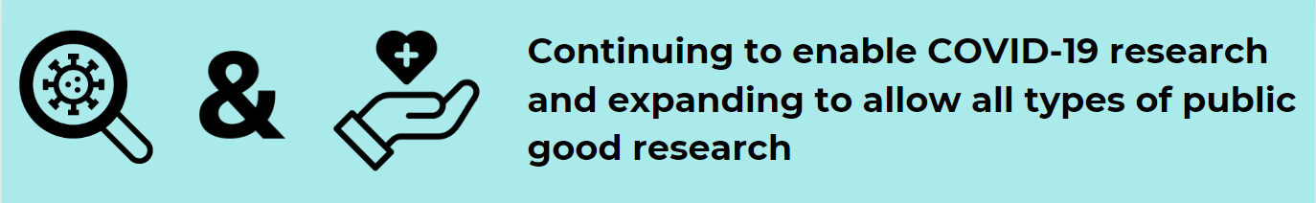
What is changing at UK LLC?
UK LLC Research Purpose
UK LLC was created in 2020 as a research resource to support researchers to understand the impacts of the COVID-19 pandemic. We have ethical approval, as well as further funding from UK Research and Innovation, Economic and Social Research Council and Medical Research Council, to continue to provide linked data for research.
UK LLC Evolution
UK LLC is preparing to make data available, within its TRE, for any public good research. Where participant agreement is in place, plans are also underway to link study data with administrative data (for example, education, employment, tax & benefits records).
How can researchers access the data?
The same robust application process applies. Only qualified and approved UK based researchers can apply to access the data within the TRE. Our application process adheres to the highest national and international standards of information governance to ensure the safest possible use of data. UK LLC are supported at multiple levels by public contributors who inform design and decision making, including on data access.
Notes:
This material and content has been co-produced by the UK LLC team with its partners. Copying and Licence information (CC-BY-SA). The material on this site is copyright (c) 2020-2024 of the University of Bristol. It is open and licensed under the Creative Commons Attribution ShareAlike License (CC-BY-SA) v4.0. CC BY-SA includes the following elements: BY – Credit must be given to the creator; SA – Adaptations must be shared under the same terms. The full CC-BY-SA text may be found at: https://creativecommons.org/licenses/by-sa/4.0/

Slide 8
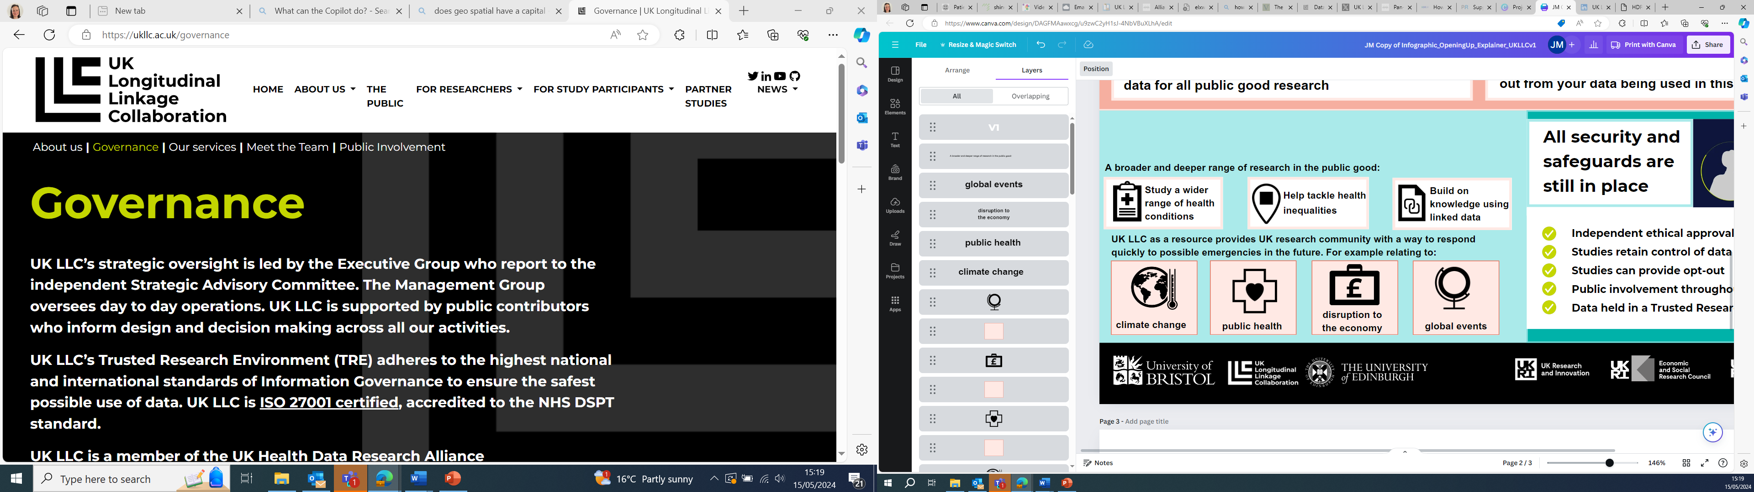
Why is UK LLC opening up?
What is the reason for this change?
By opening up UK LLC beyond a COVID-19 resource we will help researchers answer more research questions for the public good.
This will enhance researchers' ability to address important issues that affect people’s health and wellbeing and will help make vital improvements to our health and wellbeing more widely.
For example, they can examine how health and mental health conditions affect care provision among different socio-demographic groups, identify factors that can be modified to reduce risks, and understand the social impact of childhood adversity on adult health inequality.
UK LLC: Research beyond COVID-19
Notes:
This material and content has been co-produced by the UK LLC team with its partners. Copying and Licence information (CC-BY-SA). The material on this site is copyright (c) 2020-2024 of the University of Bristol. It is open and licensed under the Creative Commons Attribution ShareAlike License (CC-BY-SA) v4.0. CC BY-SA includes the following elements: BY – Credit must be given to the creator; SA – Adaptations must be shared under the same terms. The full CC-BY-SA text may be found at: https://creativecommons.org/licenses/by-sa/4.0/

Slide 9
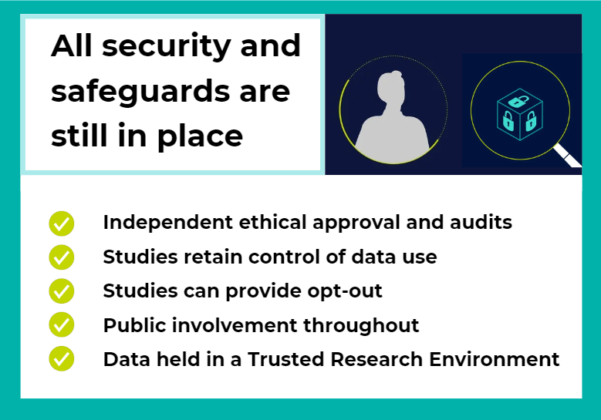
UK LLC: Still looking after
your data
?
Contact your study team if you have questions about UK LLC and/or wish to opt-out from your data being used in this way.
Notes:
This material and content has been co-produced by the UK LLC team with its partners. Copying and Licence information (CC-BY-SA). The material on this site is copyright (c) 2020-2024 of the University of Bristol. It is open and licensed under the Creative Commons Attribution ShareAlike License (CC-BY-SA) v4.0. CC BY-SA includes the following elements: BY – Credit must be given to the creator; SA – Adaptations must be shared under the same terms. The full CC-BY-SA text may be found at: https://creativecommons.org/licenses/by-sa/4.0/

Slide 10

Contact your study team if you have questions about UK LLC and/or wish to opt-out from your data being used in this way.
Notes:
This material and content has been co-produced by the UK LLC team with its partners. Copying and Licence information (CC-BY-SA). The material on this site is copyright (c) 2020-2024 of the University of Bristol. It is open and licensed under the Creative Commons Attribution ShareAlike License (CC-BY-SA) v4.0. CC BY-SA includes the following elements: BY – Credit must be given to the creator; SA – Adaptations must be shared under the same terms. The full CC-BY-SA text may be found at: https://creativecommons.org/licenses/by-sa/4.0/

